Slide 1
Emacs Use me I
Verilog mode
C-c C-d to find open module using
name at point on an instance.
M-x compile
M-x mike-compile
M-x mike/compile-irun
C-m-a jump to class definition from class body
Emacs
count-words-region
Messages lines/words/chars
M-x count-matches
Bookmark
File bookmark jump C-x-j-f
Set a named bookmark C-x-r-m, works for dired also.
Open marked from bmenu j >
Save bookmark file C-x p S, just S in the bmenu.
Switch or new bookmark file C-x p L
Jump to matching paren
Forward-sexp C-M-p
Backward-sexp C-M-n
Minibuffer Insert Newline M-’ C-j
( Meta single-quote, Control j )
(Cursor must be in minibuffer {M-e} for these to work.)
M-x display-prefix, display-numeric-prefix
M-x exchange-point-and-mark
recall set the last region (same as last paste)
ediff changed buffer file on disk
M-x ediff-current-file
Switch to buffer matching regex
C-x b followed by C-M-j
Isearch Moccur M-O at the isearch prompt (launch occur-by-moccur using the isearch string)
To enter a command like C-x <something> while the mark is active in cua mode, hold down control.
Emacs client
In the .emacs run (server-start)
CLI emacsclient <file>
-c to start a new emacs frame
3. alias(s)
ec <file>
ecc <file>
Query Replace
^ to move to the previous replacement
Scroll Other Window
>C M v
>C M S v
Removed customization of minibuffer autoraise from my
work custom Linux file on 4/1/2019, after turning off oneonone,
because it was causing ediff’s control panel to not function correctly. I don’t think that oneonone needed it. I think that I had put this in years ago when fooling around with ido in a stand-alone minibuffer. Follow up, looks like it is needed for onenone
under Windows (at least Win 8).

Slide 2
Emacs use me II
Open from cache
C-F11
Navigation
M-r end of line
M-u beginning of line
My create project file
C-u M-x my-create-project-file
(runs findme.sh)
Magit
C-c M-g l magit-log-file
P p magit-push
K git-rm-cached (remove from Git, keep local)
magit-file-checkout
Ack in Emacs
M-x ack-and-a-half-same
Rectangle
M-F9

Slide 3
use me
Create/append to short file with cat
At the command prompt
cat > file1.txt
foo
bar
C-d to end entry
use >> to append
Ack find all files of a type
>ack -f --verilog
Ack decent control
Different than grep (grep by default does not descend, ack descends by default)
-n means don’t recurse into subdirs (used with –f)
Ack list types
>ack -help-types

Slide 4
Emacs Isearch
Yank to minibuffer from edit buffer
Char C-M-y | C-z
Word C-w
Delete char at end C-M-w | backspace
Paste last kill C-v | C-y
Symbol C-_
Toggle
Case M-c
Word M-w
Regexp M-R
Edit Minibuffer
M-e to edit search string
Isearch Mocrur (moccur buffer from isearch)
M-O
Isearch History Completion
C-M-i complete then minibuffer insert
M-o complete then minibuffer append
C-z does not yank anything, emacs 24.4 Ubuntu Linux
C-_ does not yank symbol, it runs text-scale-increase

Slide 5
Emacs Sunrise Commander
From a dir pane
C-c-;
sr-follow-viewer (cd pane to eshell /term pwd)
M-^
sr-prev-subdir-other
M-o
sr-sync-panes (passive follow active
F4
sr-goto-dir
Prompts for dir in minibuffer
F11
sr-recent-directories
From eshell prompt
cd =
cd<space>=
Show dir history, index by n
Cd -n change to that dir
Navigate dir from term
M-up/down
M-M
dired-mark' on active pane
M-S-backspace
dired-unmark-backward on active pane
Clex Tags
Currently selected file at point, wo/path
%f, left pane
%F, right pane
Currently selected directory
%d ,left pane
%D, right pane
List of marked file names, wo/path
%n left pane
%N right pane
List of marked file names w/path
%m , left pane
%M ,right pane
Active pane
%a list of paths of all marked files ,active pane
%A current directory ,active pane
Passive pane
%p list of paths of all marked files ,passive pane
%P current directory ,passive pane
Cloning
K
clone active to passive, prompted for what to clone
D ignores files
C regular recursive copy all files & dirs

Slide 6
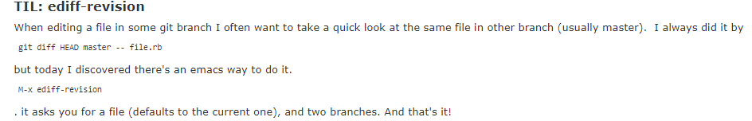
Emacs Ediff & multi-occur
ediff revision tip (TIL:today I learned)
ediff current file
multi-occur flow that works!
M-x multi-occur-in-matching-buffers
prompts for regex to match buffer names (use .*sv)
prompts for search regex
e to edit the buffer
C-c C-c exit edit
q quit occur
M-x save-some-buffers, prompted for each buffer to save.

Slide 7
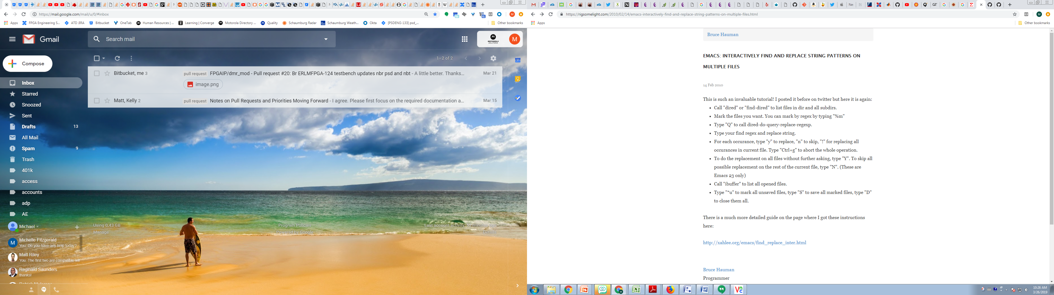
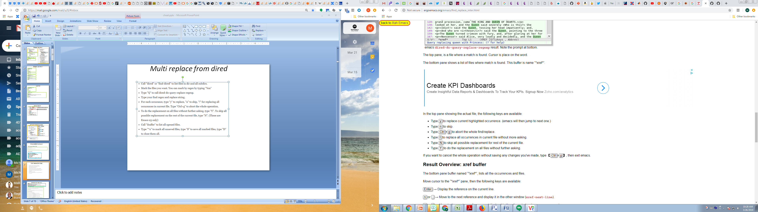
Multi replace from dired

Slide 8
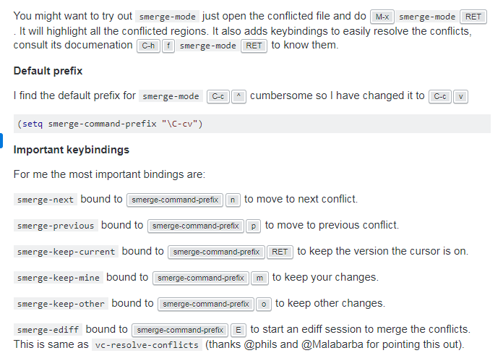
Emacs conflict resolution
Using ediff
M-x vc-resolve-conflict
- Launches ediff in a 3-pane mode, panes are named a,b,c
- a and b get interactively merged into the bottom pane c that goes all the way across.
- used n and p to move to next and previous conflict.
- q when done takes you back to the original buffer which had the conflicts, but now has been replaced with buffer c.
(don’t need to do w a to save inside ediff)
- Save the original buffer (it’s in a modified state after conflict resolution in ediff)

Slide 9
Nix I
Copy
general
cp -a is like cp –R but tries to keep the original file attributes, user, permissions etc
Contents of dir2 into dir1
cp -a dir2/. dir1/
Change current/primary group to foo
>newgrp foo
Show what groups you belong to, the group listed on the LHS is the current/primary.
groups
Change group
>chown :<group> <file>
ex
>chown :my_new_group temp.txt
Details on a folder
>stat <folder>
or
> ls –ld <folder>
Show all processes
>ps –A or ps –e
Show all processes full output
>ps –ef
Stopping a running program
C-d
End of file. It has no effect if the program isn't reading input from the terminal.
C-c
“interrupt”, i.e., stop what you're doing, but which in many programs means go back to the top level
(e.g., in a shell, stop typing a command line and go back to a prompt).
C-z
Sends the TSTP signal, which pauses the program running in the foreground.

Slide 10
Nix II
Jobs
the current job is always flagged with a +, and the previous job with a -.
The job flagged with a + is the one that was sent to the background last.
It is also the one that will be brought into the foreground when fg is used without arguments.
Use case:
Ctrl+z, then fg - to switch between two jobs.
Stop vnc server process
Find out what the server number running on remote machine, three ways
ps -ef | grep vnc | grep ptgd73 | grep --color ' :[0-9]‘
ps -ef | grep vnc | grep ptgd73 | awk '{ print $8,$9 }‘
ps -ef | grep vnc | grep ptgd73 | awk '/ :/{ print $8,$9 }' | grep --color '[0-9]'
The session number is listed in the format :<session number>
kill by session number
V
+ncserver -kill :<session number>
Note the space between -kill and the colon
This is what the output looks like with no filtering, session numbers circled in green (I find looking at the unfiltered output confusing)

Slide 11
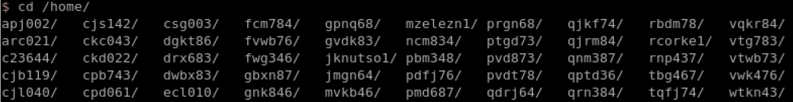
Nix II pt 5
Copy contents of folder rather than the folder itself
Given that you want to copy the contents of the ./foo folder to the already existintg ./bar folder
Use the dot operator after the slash, it means “the contents of”
>cp ./foo/. ./bar
wc use case
>some command | wlc –l
gives the number of lines produced by the command.
Where are users home directories?
/home/<user>
this is Adler, I typed cd /home/<tab>
extract .tar file
>tar –xvf file.tar
to extract the file to current directory
create .tar file
>tar –cvf tarfile_name.tar path_to_objects_to_compress/*
to create tar file
Tar options
-c create
-x extract
-v verbose
-f file

Slide 12
Nix III
Tcsh
Tcsh
End reverse isearch
>C-e or C-a
yank
>C-y
yank pop
>M-y
expand glob
>C-x *
expand history
>M-space
last arg from previous command
>M-.
‘run in backquotes’
tcsh does not have $(cmd)
Nth history arg prev command
>!:n
assignment (is different, no space around equals sign)
>set foo=‘bar’
handy for copy or moves
>set tempdir=$cwd
echo var to std out, don’t run
>echo $foo
Show all env vars0
>echo $<tab>
Name of current dir without the full path
>basename "$PWD“
Change a password
>passwd
time a script
>time
Example
>time sleep 30
produces
0.000u 0.001s 0:30.00 0.0% 0+0k 0+0io 0pf+0w
The 3rd field is the clock time
>!grep
cursor just after the p
then key M-space
expands to the most recent grep
command in history at the prompt.
create simlink (allows files to live in other places)
>ln -sf /Path/referenced/by/symlink_name symlink_name
s means symbolic
f means force
put these in a script, then run the script from a 3rd place (avoid large file creation during simulation)
example:
ln -sf $PSD_CORE/testbench/wideband_channelizer/dpath/file_chan.bin file_chan.bin
This means the ` character,
which is above the tab key,
not the single quote1
Project Alias
fs
sp
cdsuper
sps
build
cdbuild
buildme
Project Alias
$USER_APP
$HDL
$PROJ_HOME
cdph (project home)
$FPGA_FW
cdfw (framework home)
build
cdbuild
buildme

Slide 13
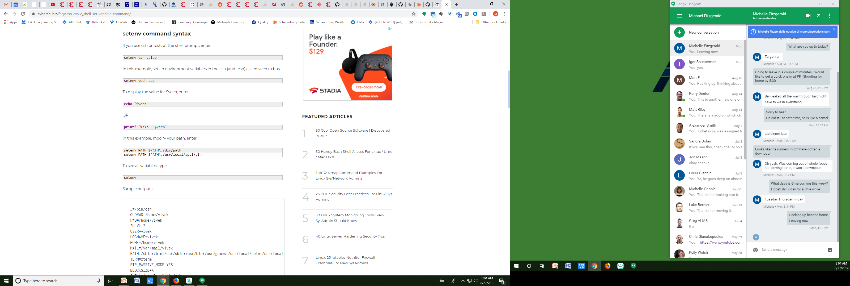
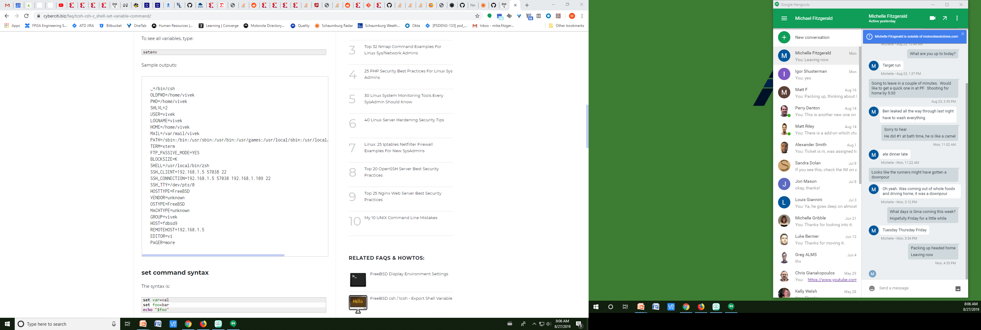
tcsh setenv

Slide 14
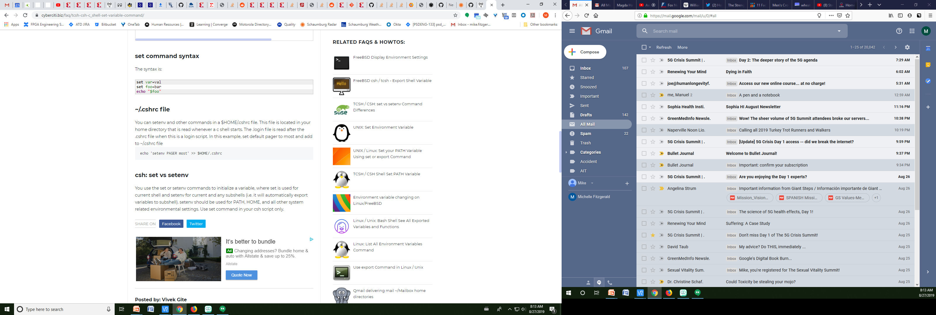
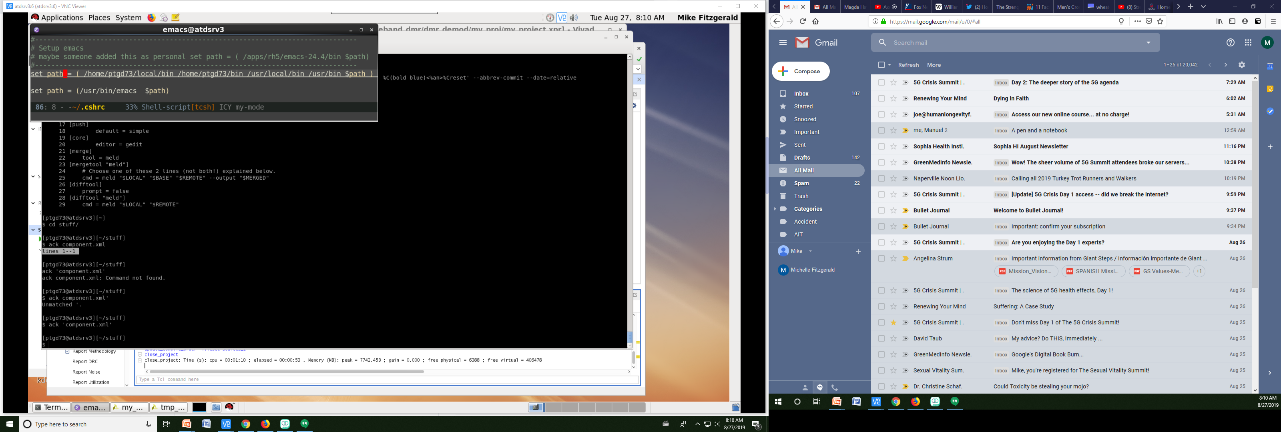
tcsh set
No spaces around the =
Always
Prepend
To the path

Slide 15
Windows
Windows key
win pause/break
Open system dialog
win home
Minimize all windows except current
win D
Show desktop
Repeat to restore window
win shift rt | left
Move window to other monitor
win up | down
Toggle vertical stretch
use this 2x to minimize current window
Windows Explorer
M-d
Jump to address bar aka “Edit url “
F4
Selects ‘go to different folder
View history
use up/dn to navigate history
Note M-d followed by F4 OK
F4 followed by M-d does not work
Backspace Switch to parent folder
Control – shift-n
Open new folder
General
ALT + underlined letter in dialog box, move to item
Cadence CAD Navigation
General CAD Navigation
ascend
out
full
out
Same program
ALT + F6 Switch windows of same program
fit
area
in
area

Slide 16
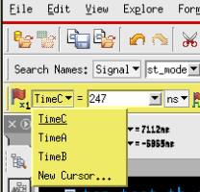
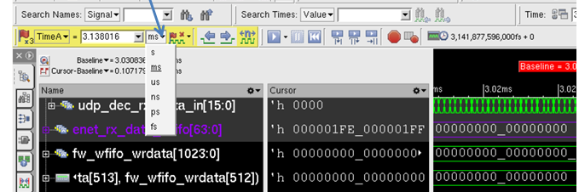
Sim Vision Wave Window
Zoom
Full =
Out o
In I
Pan
Rt ->
L <-
History
M l/R
Change radix C-S b | h | d |o |s for bin hex dec oct signed
Cursors primary and base
Set primary by left clicking
set base by middle clicking
To snap a cursor
Hover the mouse over it (cursor appearance will change to bold)
Drag it to an edge.
View/show full signal names
Explore/Count edges seems very useful (select signal first ☺)
F2 to run
To run without the GUI during simulation time:
After simulation completes
invoke SimVision
>simvision waves.shm
To get a new cursor
Change display timescale:
Click this button
Short and helpful Simvision tutorials
https://youtu.be/_TzFkAcOR5s?list=PLYdInKVfi0KYzCjnkgRgDXFJcKyQRz6eM

Slide 17
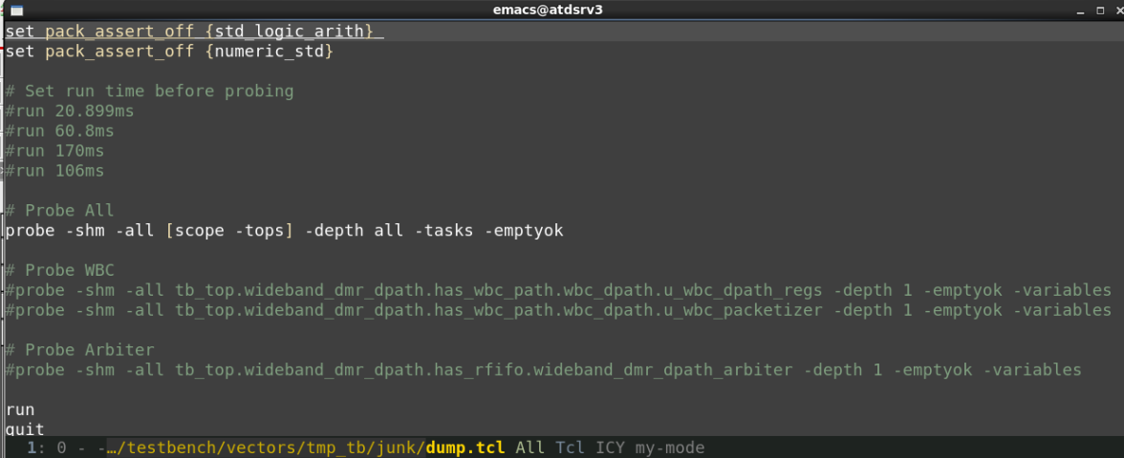
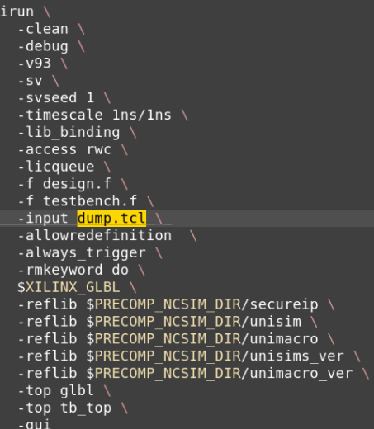
Cadence irun needs a dump.tcl to save any wave results (default folder name is ncsim.shm)
Example file
tell irun to
use the file
Note there is more going on than
wave dumping here.

Slide 18
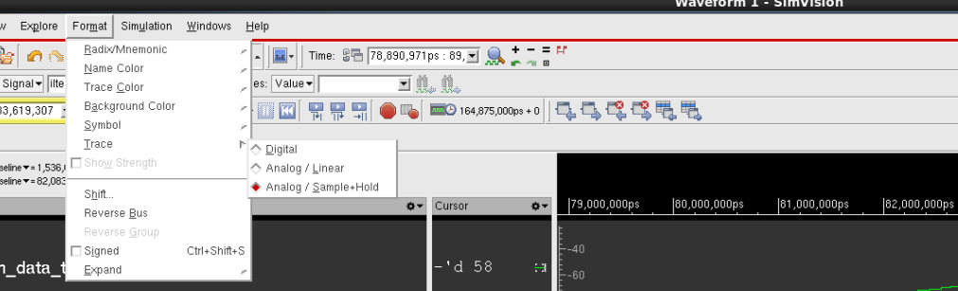
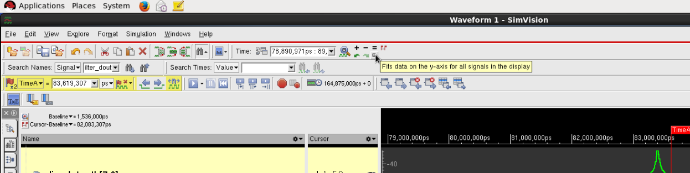
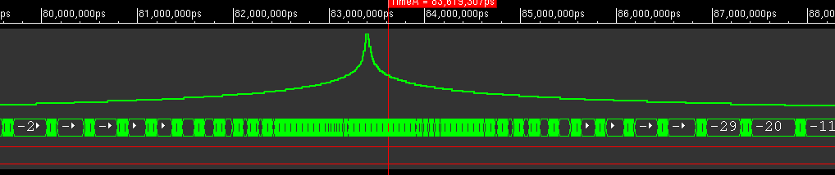
Change signal display to analog
1) Format->Analog/Sample+Hold
2) Click the small “Fit data on the y-axis for all signals..”
Results look something like this:

Slide 19
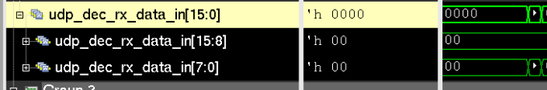
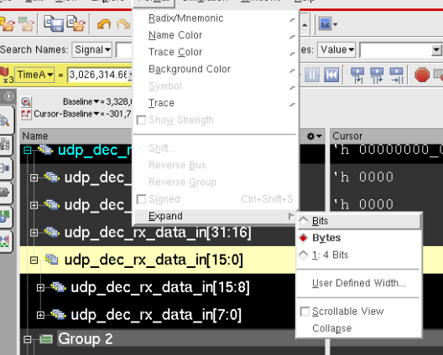
Simvision “Expand” a bus/vector into bytes/nibbles: (looks like this)
Menu: Format/Expand

Slide 20
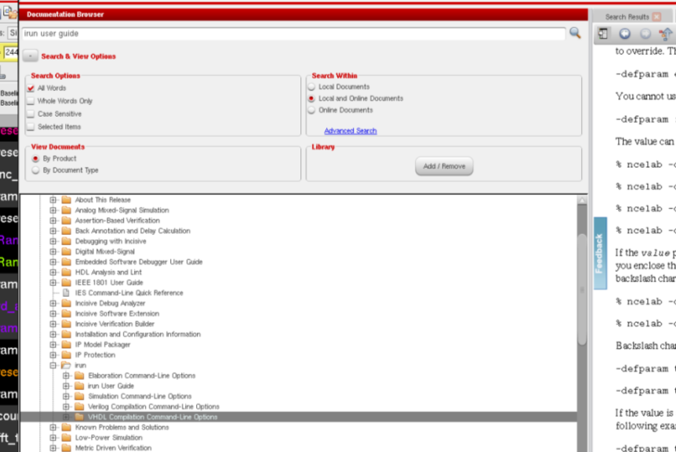
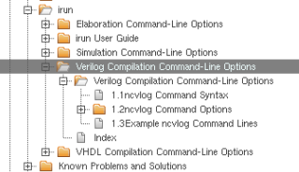
Cadence help stuff I
>cdnshelp
opens the help GUI
irun note(s)
- irun is a wrapper which runs ncvlog, ncelab, and ncsim for you
- irun accepts the ncvlog and ncelab options
-> Note how the help is organized
The ncvlog and ncelab options are
listed in their own section of the manual

Slide 21
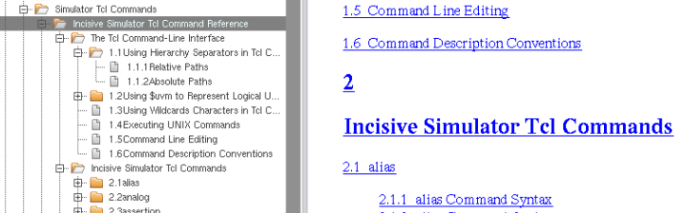
Cadence help stuff II
-> Note how the help is organized
tcl has it’s own area also
ncelab is not verbose when it errors:
Example, you get this message then irun stops:
ncelab: *F,CUMSTS: Timescale directive missing on one or more modules
To get help on this message use the nchelp ncelab command like this:
>nchelp ncelab CUMSTS
The message printed is:
nchelp: 14.20-p001: (c) Copyright 1995-2015 Cadence Design Systems, Inc.
ncelab/CUMSTS =
If any module has been compiled with a timescale directive,
the elaborator requires that all modules be compiled with
a timescale directive. Use the -messages flag to have the
timescales for each module printed. Use -TIMESCALE option to
provide a timescale directive for all modules that don't have one.

Slide 22
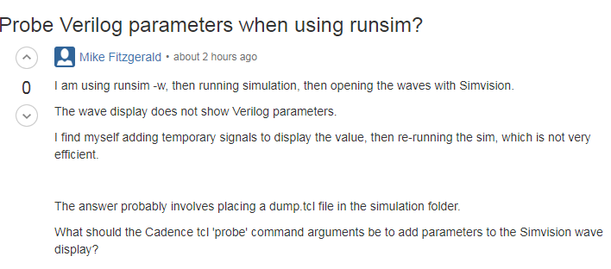
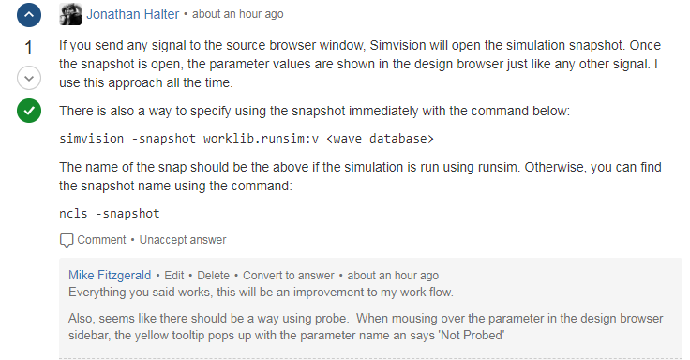
Cadence Probe parameters in runsim flow

Slide 23
Cadence license status
lmstat -c $ATD_CADENCE_LICENSE -f Incisive_Enterprise_Simulator
https://sites.google.com/a/motorolasolutions.com/csam_wiki/license-information/cadence

Slide 24
grep options
-c count
-- color=[never, auto, always]
auto does not color when piped or redirected
always can be used when piping to less –R to see colors in less
-n print line number
-A after
-B before
-C context
-h, --no-filename Suppress the prefixing of file names on output. This is the default when there is only one file.
maybe use –h with -o
-H, --with-filename, prints the filename on each line, is default when more than one file is grepped.
-v non matching
-F Interpret pattern as a fixed string (regex engine is slower)
-f FILE obtain pattern from file, one per line
-l suppress normal output, print matching file names
-L suppress normal output, print non-matching file names
-i case insensitive
-m NUM, Max, Stop reading a file after NUM matching lines
-n Print each line of output with the 1-based line number within its input file.
-o Print only the matched parts of a matching line
maybe use –o with –h for a very clean output. -q quiet; do not write anything to standard output. Exit immediately with zero status if any match is found.
-r recursive (syntax for this is convoluted, see next slide, maybe use ack which recurses by default)
-P Perl style regex (use \s to match whitespace)
-w word regexp
-x print only lines where the whole line matches the regexp
Ack
Ack does more than search files, for example:
>ack -f --perl
creates list of all the Perl files in a tree

Slide 25
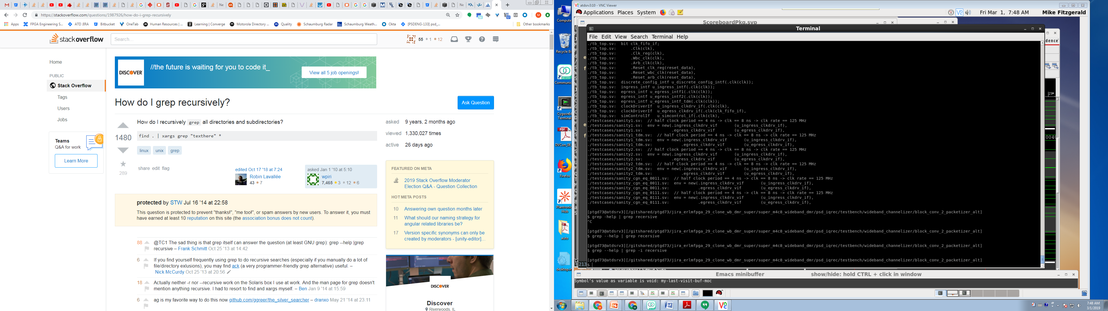
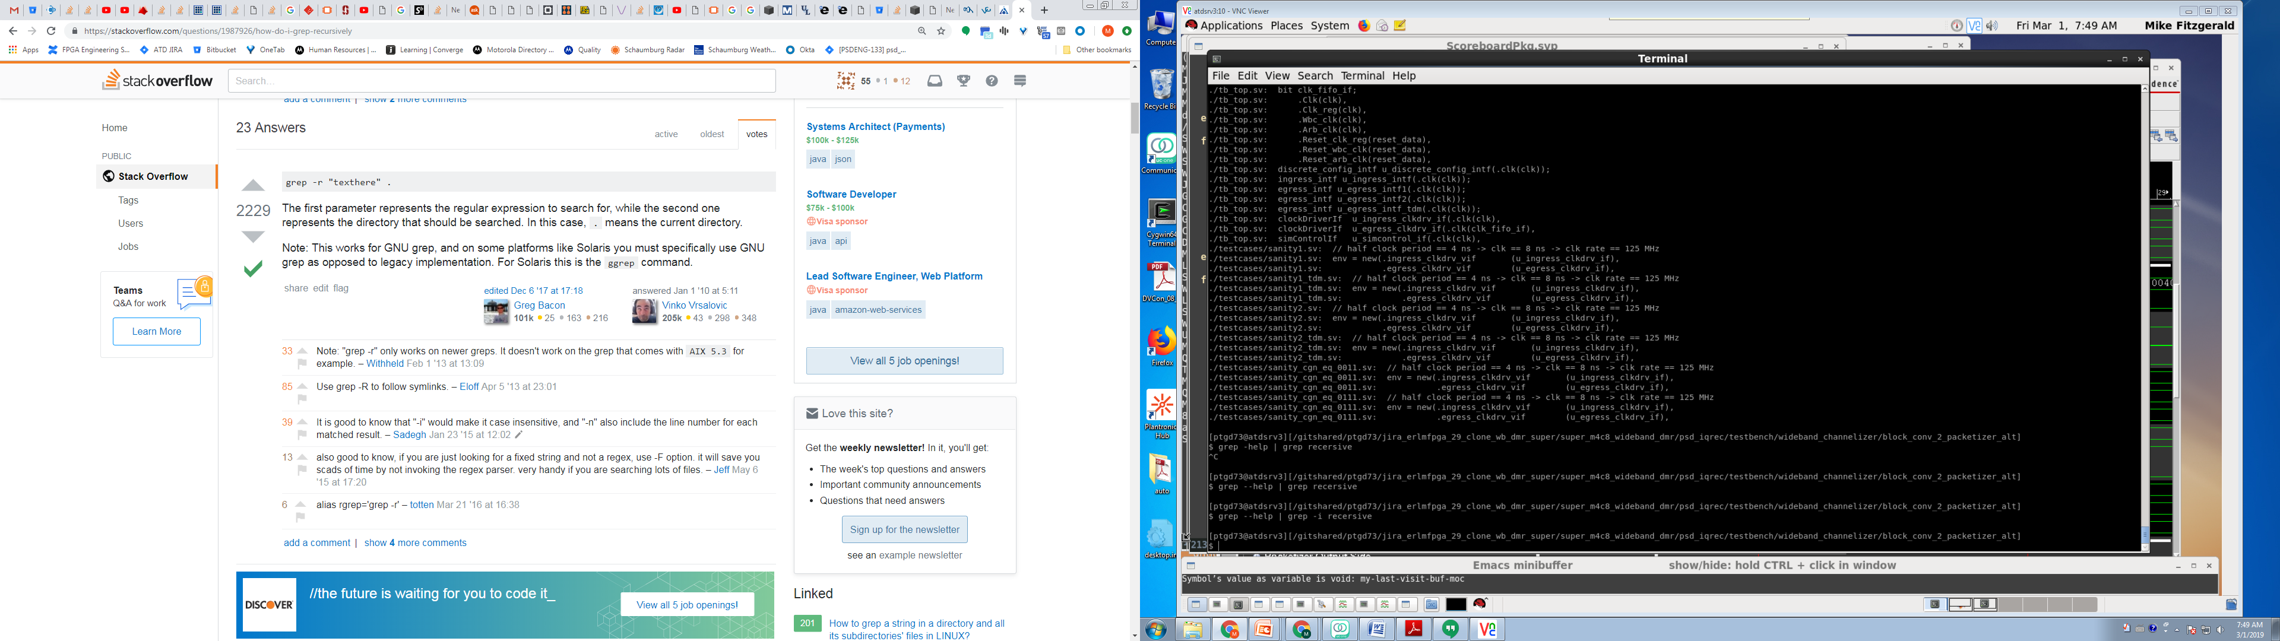
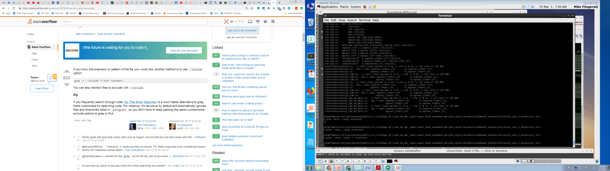
Grep Recursive syntax I maybe use ack, because it recurses by default, or use find . –iname |xargs grep how-do-i-grep-recursively
All file extensions
Limit files searched using glob
MTF, working Example
grep -r --include ‘filename maybe wildcard’ ‘regex to search’ .
grep -r --include ‘*.csh’ 'c.*dir.*log files'
glob passed to grep,
not to shell, like find

Slide 26
Grep Recursive syntax II
Start search in $PWD
grep -r --include '*.sv' --exclude-dir 'bin' 'clk' .
Search only *.sv files
search for lines
containing regexp ‘clk’
Don’t search dir named bin

Slide 27
Parenthesis shell expand vs. Regexp grouping Grep Related
Careful of parens at the command line.
Usually think about parens the from regexp perspective (that parens are literal unless escaped).
Remember that at the command line (echo foo) runs the command in a subshell.
The solution is to place parens in single quotes at the command line, to prevent expansion by the shell
> grep ‘\(foo\|bar\)’ file.txt

Slide 28
apt
>apt list –installed
>apt-get remove --purge

Slide 29
git -5 Quick Git command to see an old version of a file
git show REVISION:<path to file>
Replace REVISION with your actual revision (could be a Git commit SHA, a tag name, a branch name, a relative commit name, or any other way of identifying a commit in Git)
For example, to view the version of file src/main.c from 4 commits ago, use:
>git show HEAD~4:.emacs.d/icicles/icicles.el
This launches less type browser.
also can re-direct
>git show HEAD~4:.emacs.d/icicles/icicles.el > temp.txt
then open with emacs or something else.

Slide 30
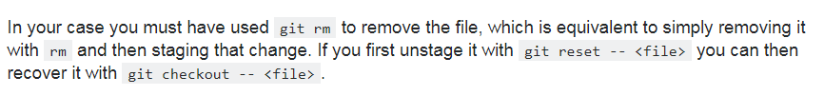
git -6 Unstage (and recover) a file which had git rm, but not committed
Recall that git removes the file as a result of running >git rm <file>

Slide 31
git -4 How do I find the most recent commit that modified a file
git log supports looking at the history of specific files and directories
>git log <path to file or folder>
extra credit
any branch use –all
This seems trivial, but it’s easy to forget.

Slide 32
git -3 show log in remote When you want to see what has been pushed. When asking “did I push this”
git log <remote>/<branch> -1
ie my emacs setup
git log origin/master

Slide 33
git -2 escape single quote in commit message
git cm 'It'\''s... going to work this time!'

Slide 34
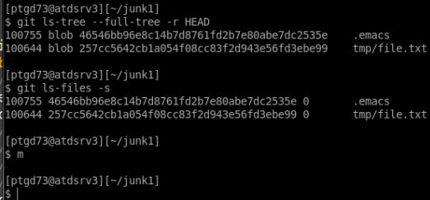
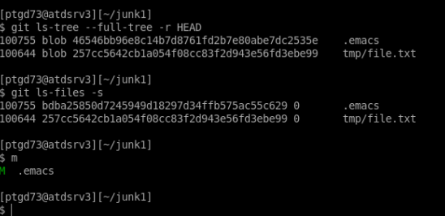
git -1 index and commit
Index is a list of blobs (git ls-files --staged)
Commit is a list of blobs (git ls-tree --full-tree -r HEAD)
When the are the same git status shows clean
index grows with each commit (unless content removed).
Mature design will have a big/ugly index
INDEX IS NOT EMPTY WHEN STATUS IS CLEAN, INSTEAD
IT MEANS THAT THE INDEX & REPO & WORKING DIR
ARE THE SAME!
The index is actually probably a complex collection of blobs.
Modified .emacs file, and added to index (blob #s different)

Slide 35
git 0
Diff after fetch to determine incoming changes
Note the lack of a from to notation and that in this context the from is the current branch
>git diff origin/<branchname>
Diff list files only
>git diff --name-only origin/<branchname>
or
>git diff –name-status origin/<branchname>
Diff ignore whitespace
>git diff -w
Diff files in different branches
Note use of relative path
Command Line diff
>git diff <branch1> <branch2> ./hdl/wideband_channelizer/wbc_dpath_pkg.sv
Launches Meld
> git difftool <branch1> <branch2> ./hdl/wideband_channelizer/wbc_dpath_pkg.sv
Diff different commits of same file
Command Line diff
>git diff <hash1> <hash2> -- ./hdl/wideband_channelizer/wbc_dpath_pkg.sv
Launches Meld
> git difftool <branch1> <branch2> ./hdl/wideband_channelizer/wbc_dpath_pkg.sv

Slide 36
git I
amend last 1 commit
(change message or add more files), must not be pushed yet
(first git add <file>, then run with –amend)
>git commit --amend -m “new message”
Use ‘--no-edit’ option to keep the same message
List files
this folder recursively
>git ls-files
files and folders this folder (no recursive)
>git ls-tree --name-only [branch]
Remove file, keep local copy
>git rm --cached <file>
Remove dir, keep local copy
>git rm --cached -r <dirname>
Push and set association:
>git push -u origin <mybranch>
the first time you push that branch. Only need to do it once, and that sets up the
association between the local branch and the one at origin.
Check out branches remote branch
>git fetch
>git checkout <branch>

Slide 37
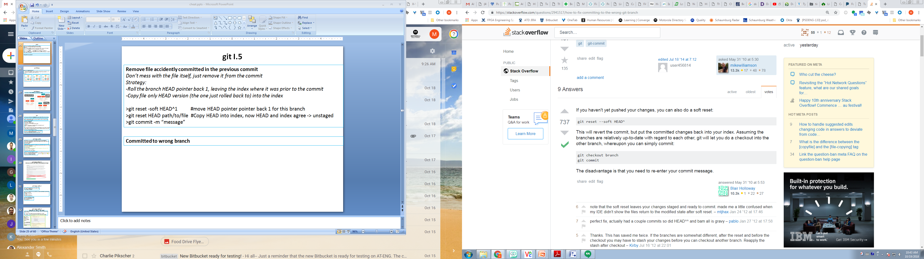
git I.5
Remove file accidently committed in the previous commit
Don’t mess with the file itself, just remove it from the commit
Strategy:
Roll the branch HEAD pointer back 1, leaving the index where it was prior to the commit
Copy file only HEAD version (the one just rolled back to) into the index
>git reset -soft HEAD^1 #move HEAD pointer pointer back 1 for this branch
>git reset HEAD path/to/file #Copy HEAD into index, now HEAD and index agree -> unstaged
>git commit -m “message”
Committed to wrong branch
1) reset soft HEAD^ moves the branch pointed back one
leaving the index alone.
2) Checkout the preferred branch
3) Commit, the new branch latest snapshot will reflect
the index.

Slide 38
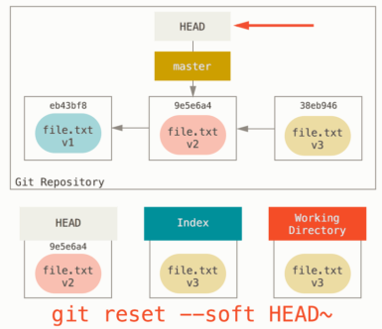
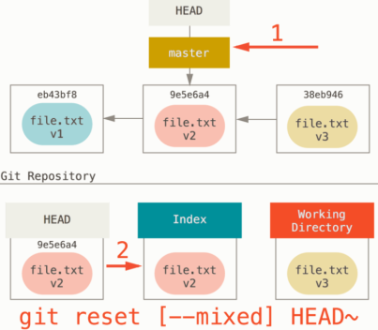
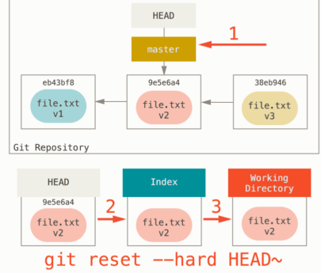
git I.75 Reset
Degrees of rollback for git reset:
-soft moves commit that HEAD points to (leaves index and working directory unchanged), use for squashing commits
-Mixed (default) moves HEAD pointer and copies new repo into into index (working directory unchanged)
-hard does 1) and 2), also copies new repo files into working copy
With a path, git can only perform the above on a file (can’t do 1 only does 2), which is the way to unstage (remove from the index) a file.
git reset defaults
>git reset –mixed HEAD
>git reset <mode> commit

Slide 39
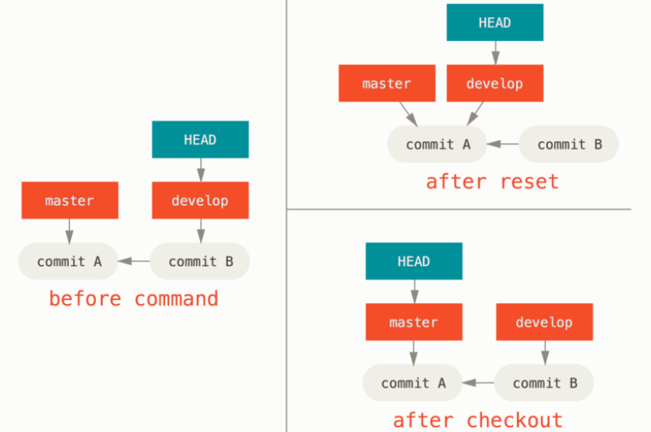
git I.76 Reset II
reset moves the branch HEAD points to, checkout moves HEAD.
git reset master
Remember there is only
one head pointer per git repo!
Reset maintained
the branch
git checkout master
Checkout changed
the branch
checkout is working directory safe,
reset –hard is not

Slide 40
git II
Do merging on atdsrv3, not latdc03043 to be more confident of the git version,setup,…
After a merge conflict, repeat the git merge command, it may have stopped mid way
when the conflict happened.
Squash 3 commits into 1
>git rebase -i HEAD~3
- Interactive session launched
Leave the first alone, change 2nd two to squash
save,quit
another editing session is launched, edit the final commit, save, quit
Done, use git log -2 to see the result
The new message format will list all of the squashed messages with a newline in between
listed newest at the bottom, oldest at the top. Not a bad idea to remove the new lines,
and put a squashing message at the top.
View a file in a different Git branch without changing branches >git show somebranch:path/to/your/file
relative path works, but you need ./<file> not just <file>

Slide 41
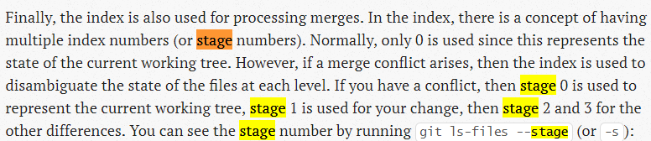
git III merge conflict
Get back to pre merge after merging and discovering conflicts I go back/abort
useful when manual resolve of conflicts has gone bad you want to start the merge over
>git merge feature_branch
conflict discovered
>git merge abort
Return to pre merge state after merge & discovering conflicts, then choose ‘ours’ or ‘theirs’
>git merge feature_branch
conflict discovered, roll back the merge:
>git merge abort
Now you are back to the pre merge state, perform merge again selecting ours or theirs:
>git merge -X ours feature_branch
or
>git merge -X theirs feature_branch
Create a local copy of common, ours and theirs
>git show :1:hello.rb > hello.common.rb
>git show :2:hello.rb > hello.ours.rb
> git show :3:hello.rb > hello.theirs.rb

Slide 42
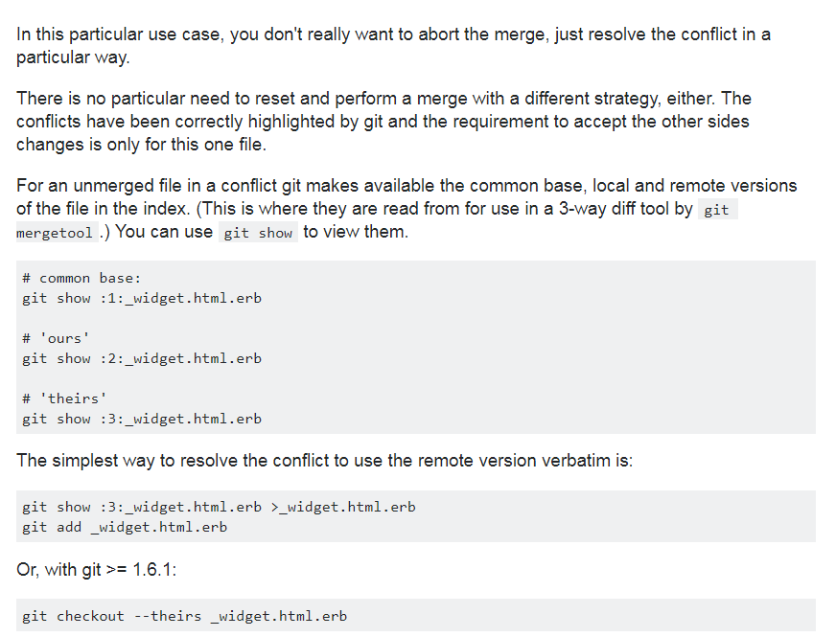
git III merge conflict 1.5 Select ours or theirs after merge without aborting the merge

Slide 43
git III merge conflict II
To finish the merge after manually fixing the conflict
>git add conflicted_file.txt
> git commit -m “merged”
To resolve conflict where file was modified in one branch and deleted in another branch.
Decide keep or delete
if keep
>git add file_to_keep.txt
if remove
>git rm file_to_remove.txt
To launch meld as the mergetool
I set up as directed here
The instructions are to run
>git mergetool

Slide 44
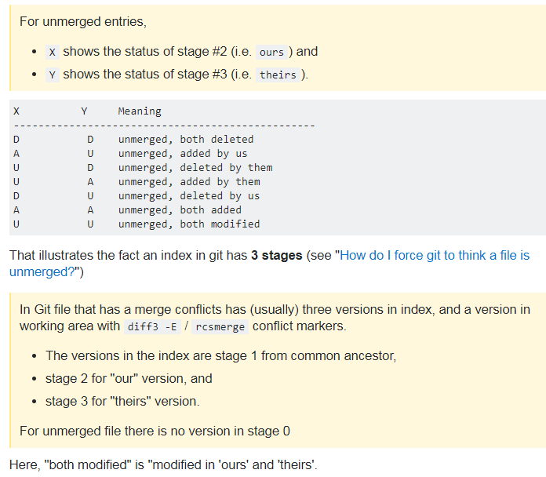
git III merge conflict III Explanation of ‘status XY after merge’
After merge conflict manual resolution the merged file may still show something like
>UU for status.
It is trying to tell you about the two parents and why there is a conflict.
For example one parent tried to delete the file and the other parent changed it.
This is the
Stack overflow answer
for what does
‘both modified’
mean?
one comment was:
It's modified "since" or
compared to both parents.

Slide 45
git V
Merge No FF
Why?
So that a merge commit is created to have a record of where the branch was brought back
>git merge --no-ff <branch>
It opened a editor to create a message, so it probably takes a -m “<message>” option

Slide 46
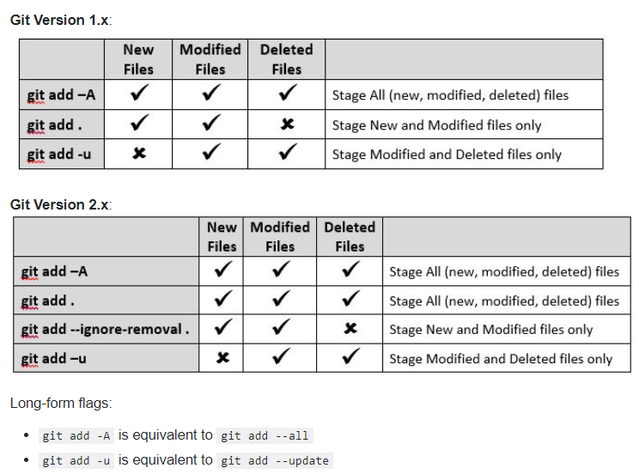
git VI.1 how to stage 1)current folder, 2) All modified and deleted without staging untracked
-u is
update index
On the
current path
only!
Very useful!

Slide 47
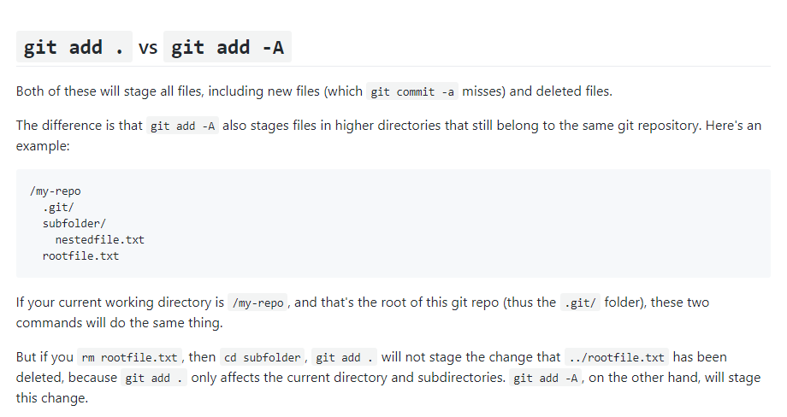
git VI.2 git add –A vs git add .

Slide 48
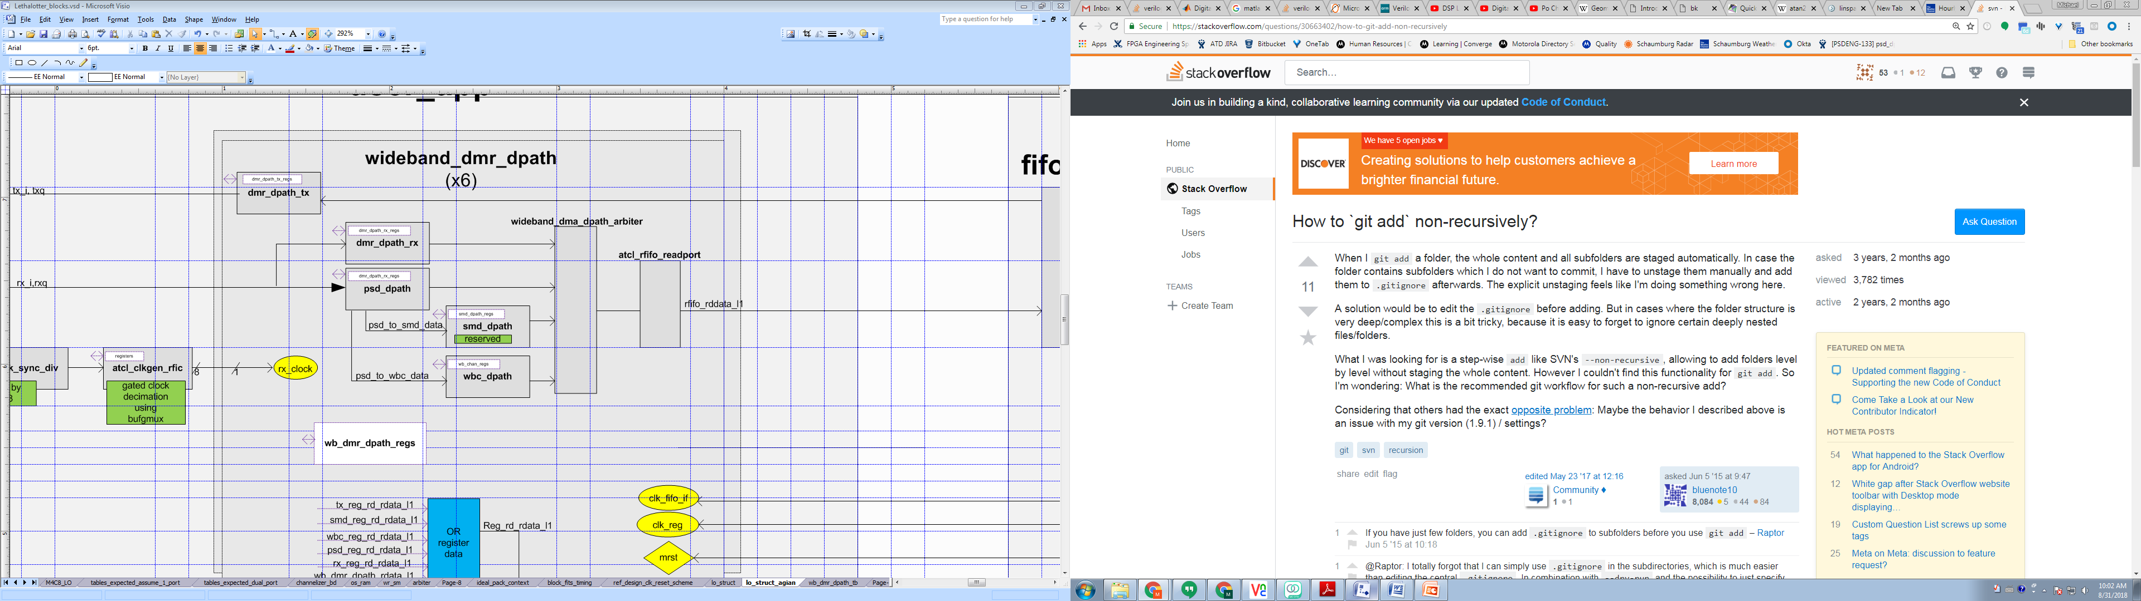
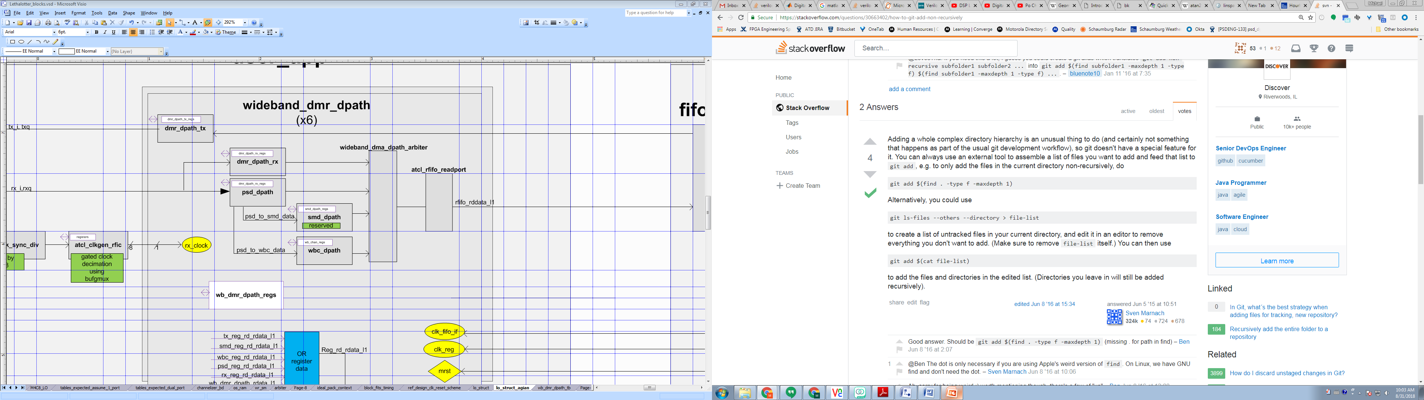
git VI.3 how to stage Current folder only, don’t recurse into subfolders
For TCSH (use backquotes above tab key,
not the single quote, also not $(cmd) )
>git add `find . –type f –maxdepth 1’

Slide 49
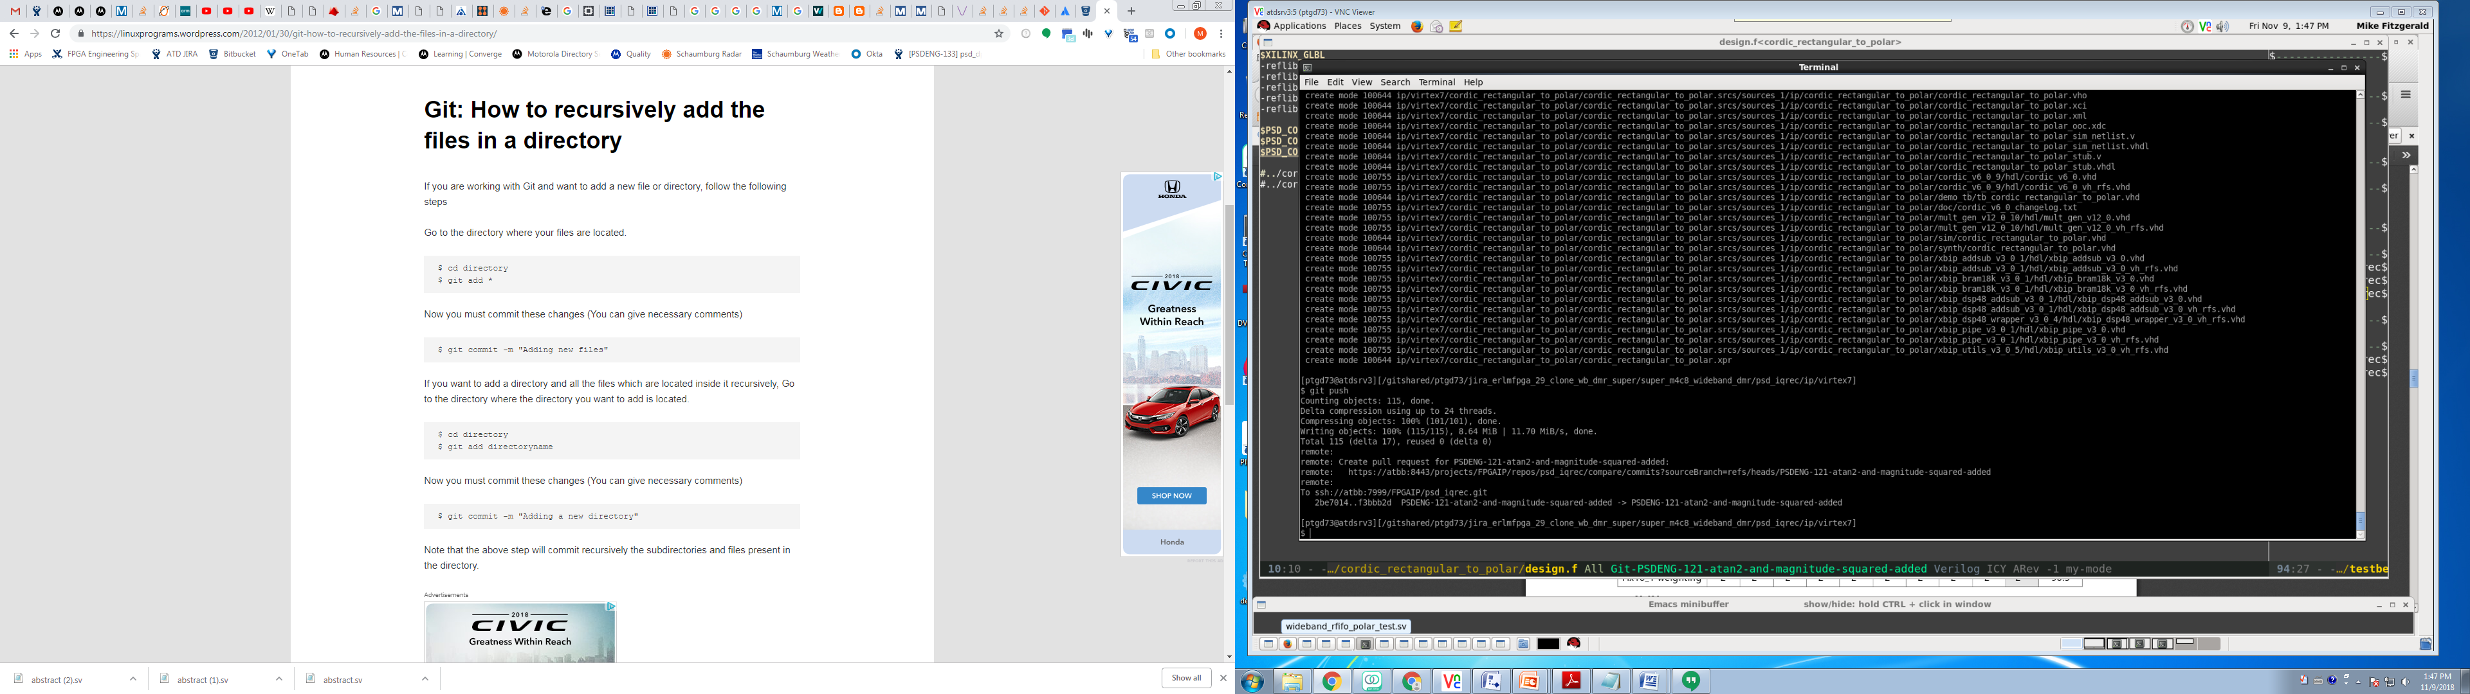
git VI.4 how to recursively add the files in a directory

Slide 50
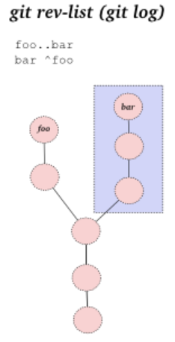
git VII Git Stuff
Bare double dash --
Contrast the control portion of the command line from a list of operands.
Use to separate and explicitly identify filenames if the might otherwise be mistaken for
another part of the command.
Example: You have a file and a tag named main.c, then there will be a difference between
#checkout the tag
>git checkout main.c
#checkout the file
>git checkout -- main.c
double dot
For branches A and B
git log A..B
will show you all of the commits that B has that A doesn't have.
Checkout the previous branch
>git checkout s

Slide 51
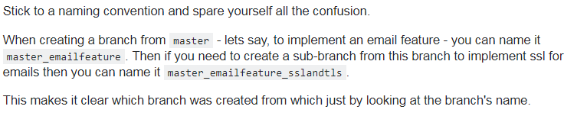
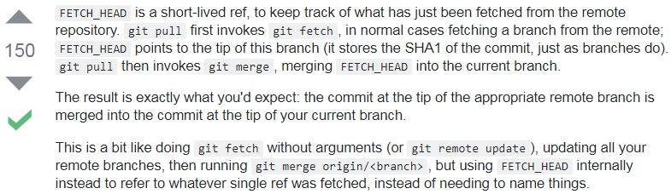
git VII.5 More Git Stuff
How do I know where the branch I am on came from?
What is FETCH_HEAD?

Slide 52
git VII.75 Still More Git Stuff
How do I name branches
br_<branch name>
or
<function>/br_<branch name>
<function> can be
feature
bugfix
hot fix
release
custom
Remember
pulling or fetching only does the current repo/submodule
Delete remote branch
SO Link
Created a bad branch name, wanted to remove it (has .sv at the end)
This was allowed, a bit surprised, however there were no commits (local or pushed) to this branch.
Had already done a fetch, so it existed locally
Start from a point where another branch was checked out (can’t delete it if it’s the current branch)
>git branch –d feature/br-ERLMFPGA-53-wideband_dmr_dpath_regs.sv
>git push origin --delete feature/br-ERLMFPGA-53-wideband_dmr_dpath_regs.sv

Slide 53
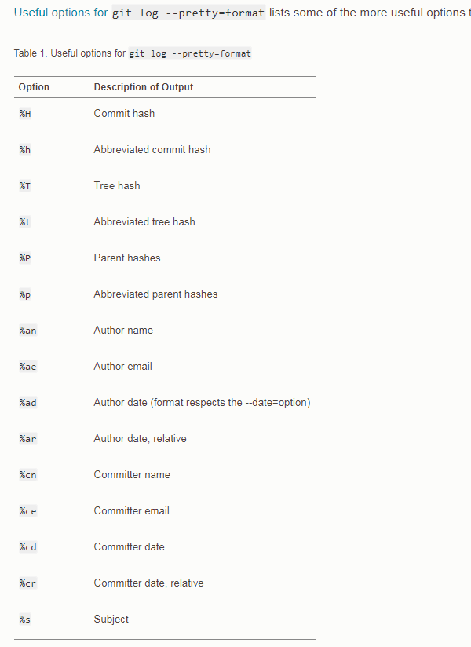
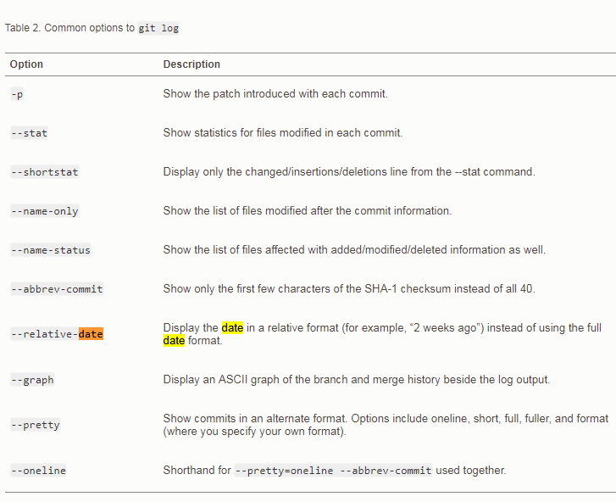
git VIII Git log options
Shows the diff ‘what changed’

Slide 54
git IX Git Diff
list files only
>git diff –name-only
no args
shows what will go into the index
branch against it’s upstream
Need the branch names
Find the branch names using git branch –a
git diff <branch> <branches_upstream>
Current branch against other branch:
$ git diff --name-status master
Any two branches:
$ git diff --name-status firstbranch..yourBranchName
Changes among files:
Files on two named branches
git diff branch1 branch2 -- myfile1.js myfile2.js
Branch1 is optional, current branch considered default:
git diff master -- controller/index.js
or
git difftool master -- controller/index.js

Slide 55
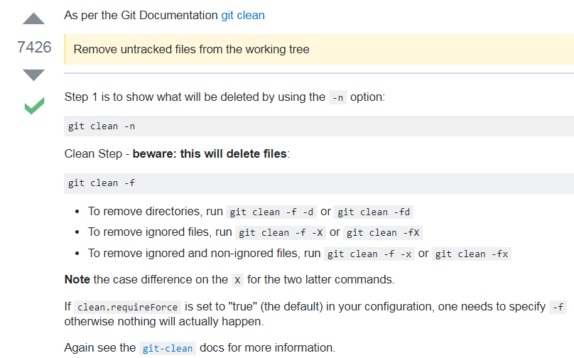
git X Git clean (how to remove untracked)

Slide 56
git XI
Pull request
A pull request is a server side merge.
To make a pull req, first merge the main branch to the feature branch and resolve
conflicts locally.
Some of the main branches are locked down, so there is no push.
You can only write/push them by a pull request.

Slide 57
git XII Stash
Note that stash is not required to move between branches. If a file is added to the index but not committed you can just switch branches & commit.
git stash action: - Stashes changes to tracked files (modified or added to index).
But it will not stash:
- New files in your working copy that have never yet been staged (untracked)
- Files that have been ignored
Adding the -u option (or --include-untracked) tells git stash to also stash your untracked files
>git stash push –m “my message”
Pushes the change to the stash list with a message.
>git stash pop
Popping your stash removes the changes from your stash and reapplies
them to your working copy.
>git stash apply
Reapplies the changes to your working copy and keep them in your stash.

Slide 58
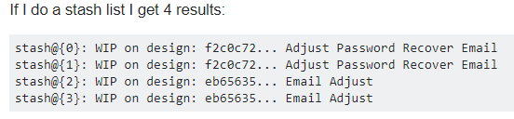
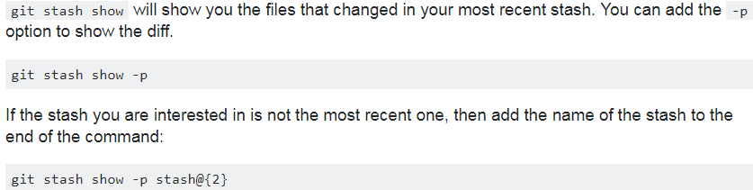
git XI Stash II
Applying a stash from the list of stashes
The keys into the stash are the stash@{n} items on the left.
>git stash apply stash@{0}
etc.
( in tcsh quote like this: "stash@{0}“ )
-p means show diff

Slide 59

git XIII tag

Slide 60

Git XIV Remove untracked files

Slide 61

GIT XIV Rebase Squash 3 commits into 1, (removing two commit messages)
>git rebase –i HEAD~3
Leave the first, change the 2nd two to squash

Slide 62


GIT XV LFS Add
Add folder and it’s contents recursively
yes,
Is the psd_iqrec folder there is already a
.gitattributes file, so run git lfs add from there to have this file be the one and only
.gitattributes file for the repo
Don’t forget to add changes to the gitattributes file to git, and push

Slide 63

Xah Lee Magit
Magit

Slide 64
SV Event Scheduler
From previous
time slot
Region Sets
Regions
Details
Preponed
Preponed
read assertion
values
Active
Read rhs and assign lhs blocking assignments
Active
Inactive
#0 delay
don’t use
Read rhs NON blocking assignments
Events in active region
execute in any order
Active
NBA
make continuous assignments
$display command
Time
Observed
Observed
assert
assertions
NBA
assign LHS NON BLOCKING assignments
Active
Reactive
Inactive
All three are for
program block
don’t use
NBA
To next
time slot
Post
Post
Post
$monitor and $strobe

Slide 65
SV Event Scheduler Simplified
From previous
time slot
Region Sets
Regions
Details
Preponed
Preponed
read assertion
values
Read rhs and make lhs BLOCKING assignments
Read rhs NON blocking assignments
Events in active region
execute in any order
Active
Active
Active
make continuous assignments
$display command
$display can happen more than 1x/time, because of the loop.
Time
NBA
NBA
make LHS NON BLOCKING assignments
assert
assertions
$monitor asserts on signal change, only 1x per simulation.
To next
time slot
Post
Post
Post
$monitor and $strobe

Slide 66
Tmux, wimmi
>tmux -2 gives 256 colors rather than 8
Check out wimmi tiling window manager

Slide 67
Chrome
New tab
C-t
Open last closed tab
C-T
Close tab
- C-F4
C-w
Open Downloads folder
C-j
Move cursor to search bar
C-l/F6
Print
C-p
Bookmarks
C-O
Hide Show Bookmaks
C-B
Bookmark page
- C-d

Slide 68
SystemVerilog Websites
verificationguide.com
chipverify.com
vlsi.pro
svref.renerta.com
testbench.in
asic-world.com
markhardy.info
tenthousandfailures.com
www.fullchipdesign.com

Slide 69
SystemVerilog Testbench Dance Variations
verification guide style
pre_test
- resetDut
- configureDut
test
- fork
gen_main
drv_main
mon_main
scb_main
post_test
Chris Spear Book style
build
- generate configuration
- build enviornment
- reset Dut
- configure Dut
run
- start enviornment
- run tests
- wait for done
wrap up
- sweep
- report
testbench.in style
Run
- build
- reset
- cfg_dut
- start
- wait_for_end
- report

Slide 70
Websites
Best simple bottom line Python Web site
python_tutorials

Slide 71
Local Places (maybe a better name than this)
Matlab learning/experiments
~/stuff/matlab_examples

Slide 72


Verilog coding helpers I
peanut
logic <packed dimension> <signal name> <unpacked dimension>
motion
(
mode type name,
mode type name
);
my top secret peanut
mode type signed <packed dimension> <name> <unpacked dimension>
m-piano
olympiad
- module
- parameters
- instance
- association
- dun
- parameters
- instance
- association
man pads program
MODULE <name>
PARAMETER
ports
MODULE dun
PARAMETER
ports

Slide 73
Verilog need to know I
Null statement
This is an warning
If(a==2)
else
a_eq_2 = 1;
This is not a warning (put in a begin/end pair)
If(a==2)
begin
end
else
a_eq_2 = 1;

Slide 74
Generate label
Labels are helpful for
1) Seeing the new scope in waves named as you named it not a machine generated name.
2) A named space for a hierarchical reference to refer to
generate
begin :somename
<statements>
end

Slide 75

Verilog coding helpers I.5
single side band value
<size>’<signed><base><value>

Slide 76



Verilog coding helpers II Interface/Clocking block
In this example the behavioral
stimulus is in the structural testbench.
It typically would be in a class using
a virtual interface to connect.
Note the edge is specified
in the clocking block, not
when the event is used.
Timing references
provided by the clocking
block event.
Accesses to the signal
in the interface
are provided by the
clocking block reference.

Slide 77
Xilinx Documentation
Xilinx Doc | Purpose
UG 472 | Clocking Resources (bufg, bufr, etc)
UG 761 | AXI Reference
UG 835 | Tcl Reference
UG 888 | Design Flows Overview
UG896 | Designing With IP
UG 903 | Using Constraints
UG900 | Simulation
UG901 | Synthesis
UG994 | Designing With IP Integrator
UG1118 | Creating and Packaging Custom IP
Xilinx Doc | Purpose
PG 105 | CORDIC 6.0
Xilinx Doc | Purpose
DS 180 | 7 Series Overview

Slide 78


xc7vx485tffg1157-2

Slide 79

https://www.youtube.com/watch?v=p3V3TITSDxc Inflamatiory process causes adrenels to secrete cortizol and that slows down the thyroid.

Slide 80

bergman

Slide 81

bergman

Slide 82

bergman Low functioning dangerous.

Slide 83

How to focus in the age of distraction

Slide 84

Eclipse DVT
>source /apps/fpgaenv/setup_tool.csh dvt 18.1.39
>dvt.sh
// Pat’s preferences.ini file, is shown in the gui.
+dvt_auto_link_root+super_fw_dev=${GIT_VIEW_PATH}/super_fw_dev +dvt_init+ius.irun -v93 -f runsim.f
Sorry I did not get that to you sooner

